Slide 1
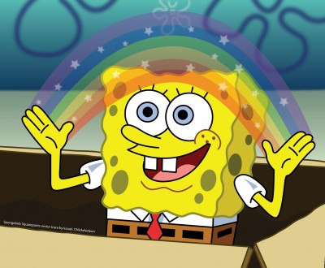
Imagination and its types
Made by: Danila Seluyanov

Slide 2
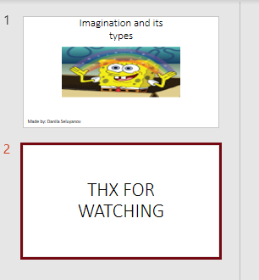

What is an imagination?
Making a cool presentation for English class
Imagination
(expectation)
Reality

Slide 3


Representation of actual images

Slide 4
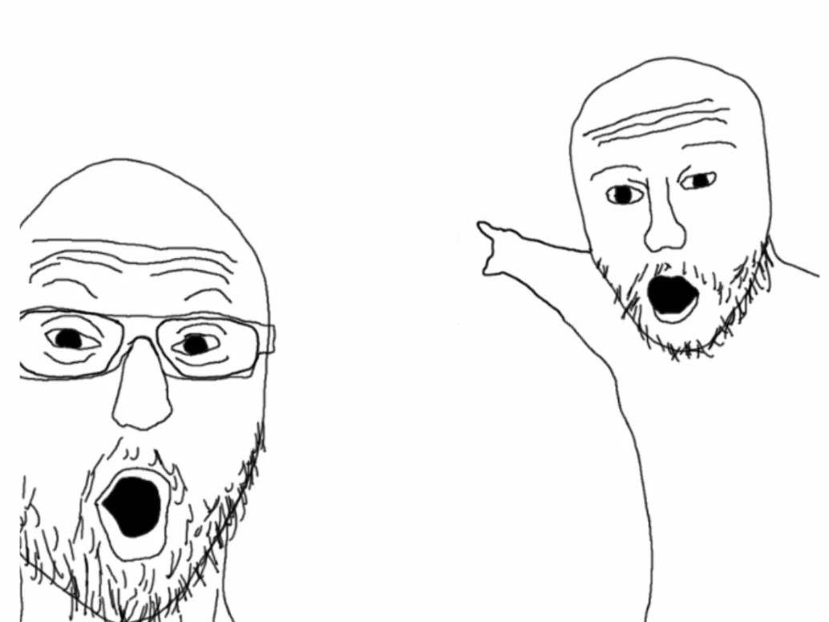
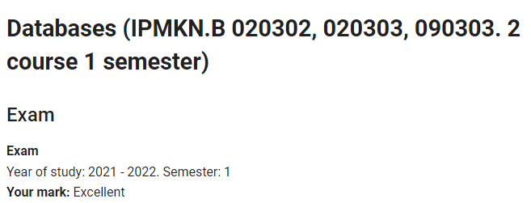
Regulation of emotional states

Slide 5
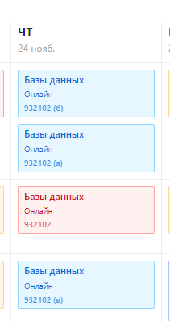


Formation of an internal action plan Planning and programming of your activities

Slide 6
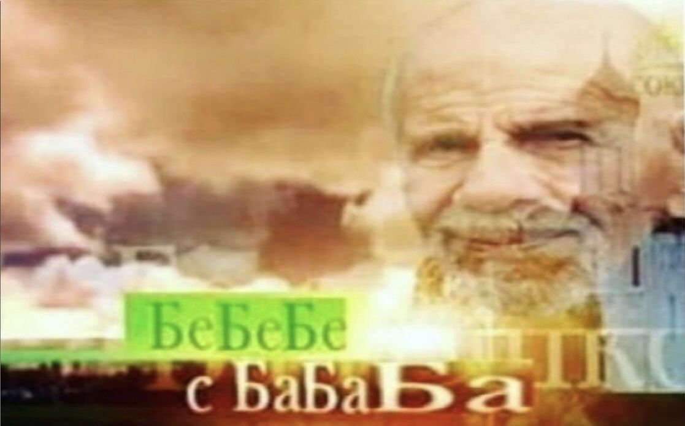
THX FOR WATCHING

